Slide 1



Talk Circles
1: Introducing Oracy

Slide 2
Aims
Understand
The term ‘oracy’ and how it supports teaching and learning
Different types of classroom talk
The characteristics of effective student talk
Do
Identify opportunities for oracy in your classroom
Analyse examples of student talk using the Oracy Framework

Slide 3
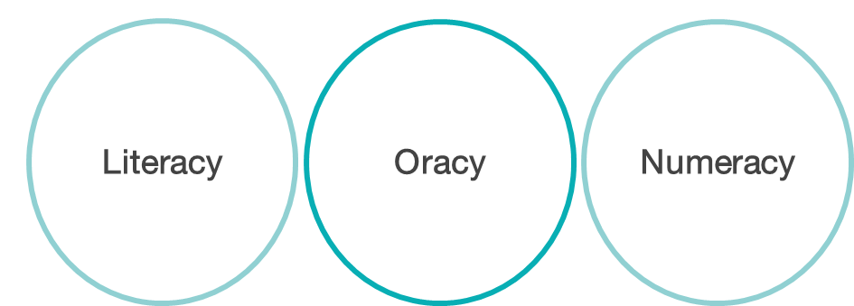
What is oracy?
A neologism
Oracy is articulating ideas, developing understanding and engaging with others through speaking, listening and communication

Slide 4
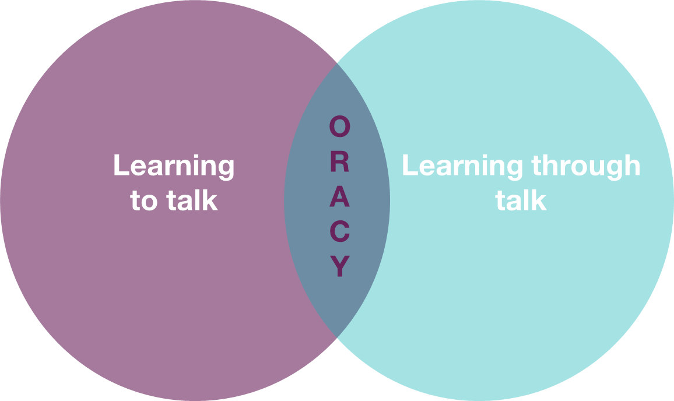
What is oracy education?

Slide 5
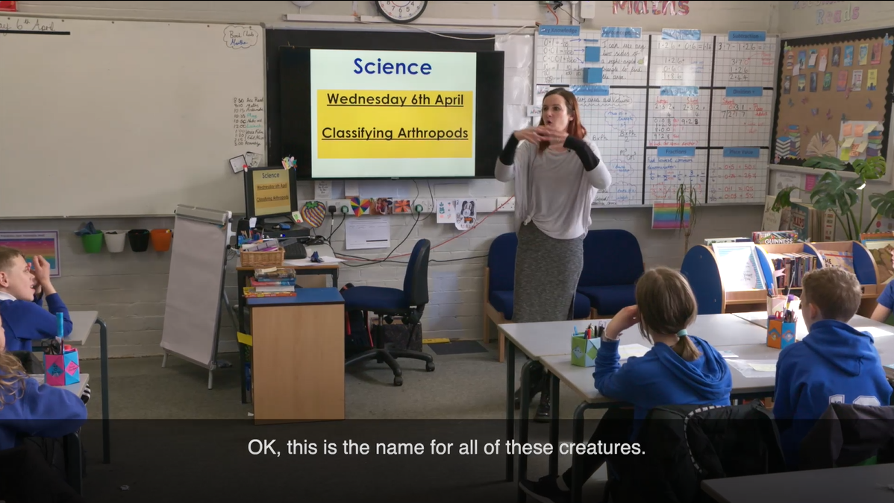
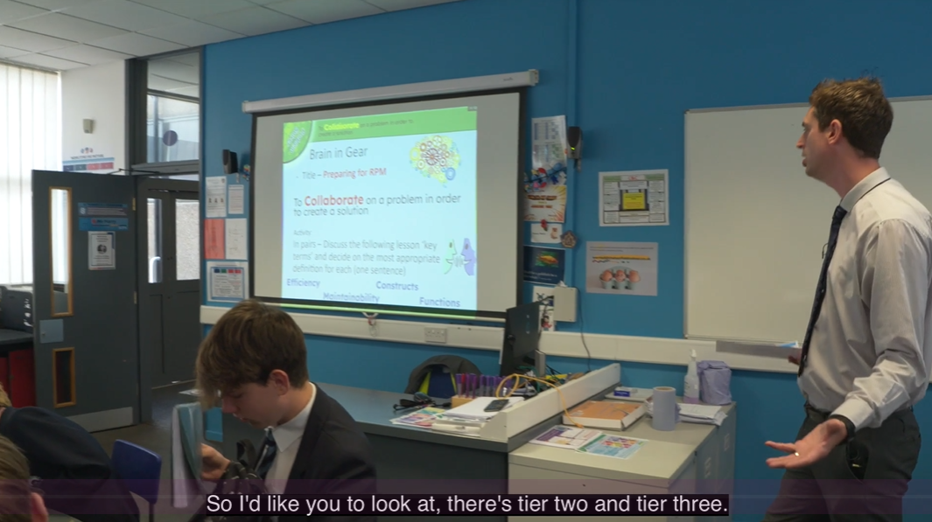
Oracy in action
How do students learn to and through talk in these clips?

Slide 6


Slide 8

Oracy in action
A: I noticed that…
B: I wondered why…

Slide 9

Key ideas
To engage in high-quality, academically productive talk, students must learn how to talk effectively in this context.
In an oracy-rich classroom, students have opportunities to share, develop and consolidate their understanding through talk.

Slide 10

Oracy in your classroom
What opportunities for oracy are there in your classroom?

Slide 11
Exploratory vs presentational talk
Exploratory talk
‘exploratory talk which is typical of the early stages of approaching new ideas […]Exploratory talk is hesitant and incomplete because it enables the speaker to try out ideas, to hear how they sound, to see what others make of them, to arrange information and ideas into different patterns.’
Presentational talk
‘The difference between the two functions of talk is that in presentational talk the speaker’s attention is primarily focused on adjusting the language, content and manner to the needs of an audience, and in exploratory talk the speaker is more concerned with sorting out his or her own thoughts.’
*Barnes, 1992

Slide 12

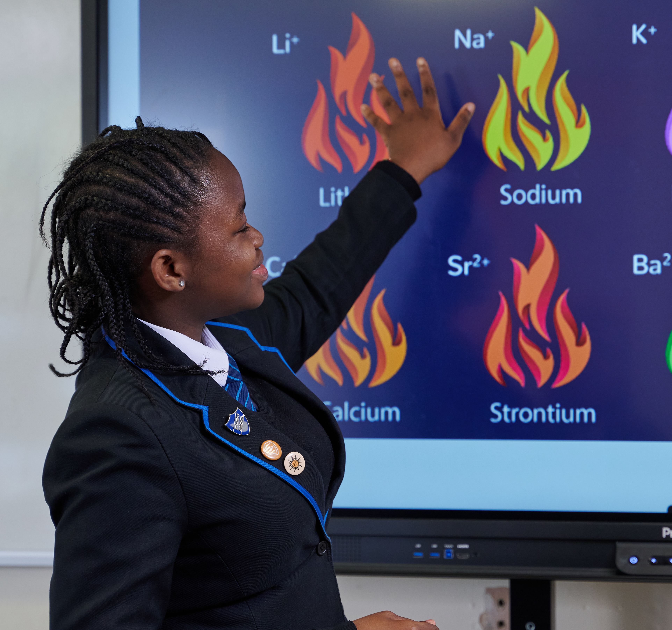
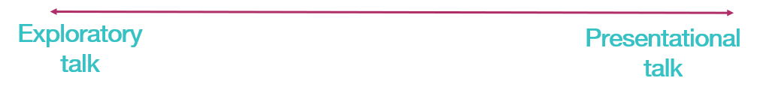
Exploratory vs presentational talk

Slide 13




The Oracy Framework
Cognitive
The deliberate application of thought to what you’re saying
Linguistic
Knowing which words and phrases to use, and using them
Physical
Making yourself heard, using your voice and body as an instrument
Social & Emotional
Engaging with the people around you; knowing you have the right to speak

Slide 14
The Oracy Framework
Building on the views of others
Turn taking
Cognitive
Volume of speech
Use of gestures
Linguistic
Summarising
Giving reasons to support views
Register (level of formality)
Structure and organisation of talk
Physical
Listening
Vocabulary choice
Social & Emotional

Slide 15
The Oracy Framework
Building on the views of others
Turn taking
Cognitive
Volume of speech
Use of gestures
Linguistic
Summarising
Giving reasons to support views
Register (level of formality)
Structure and organisation of talk
Physical
Listening
Vocabulary choice
Social & Emotional

Slide 16
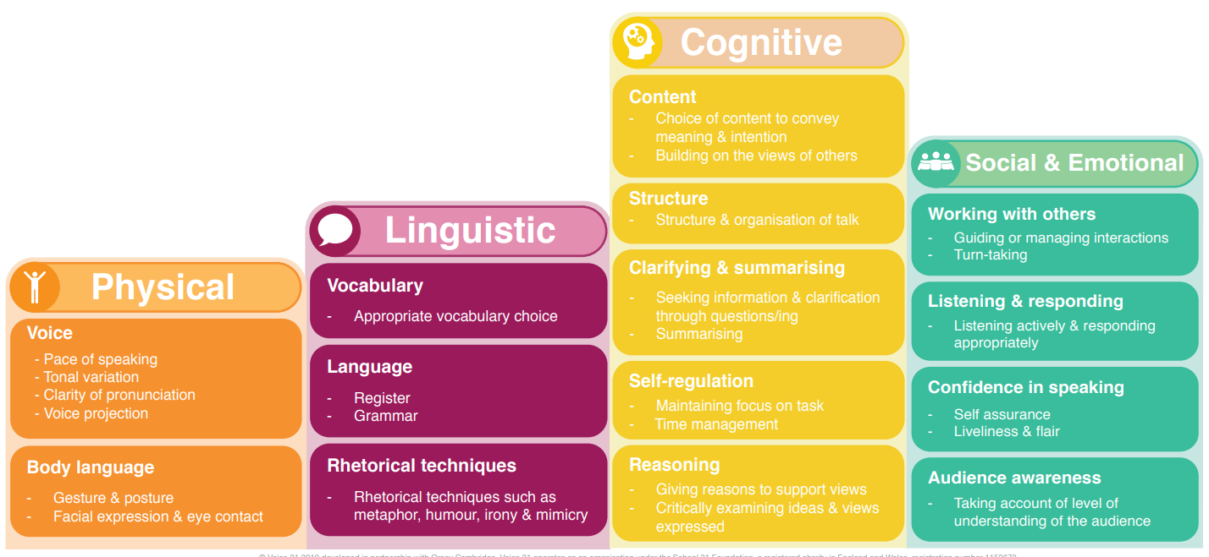
The Oracy Framework

Slide 17
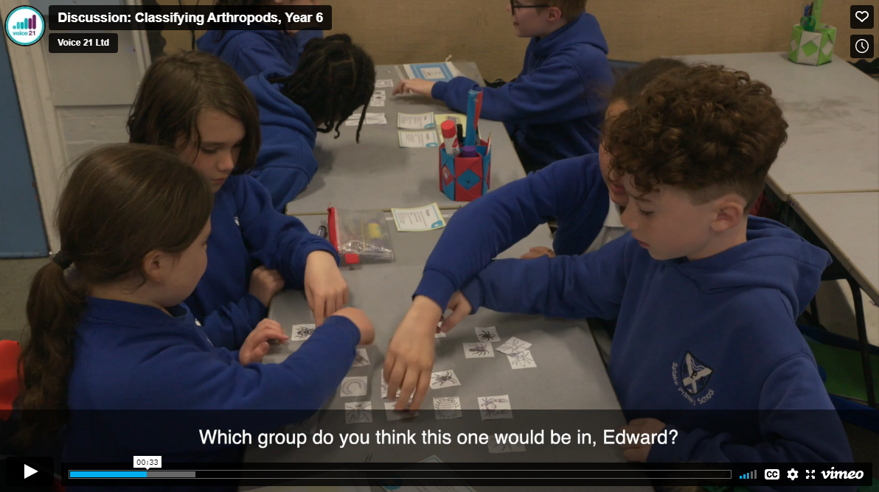
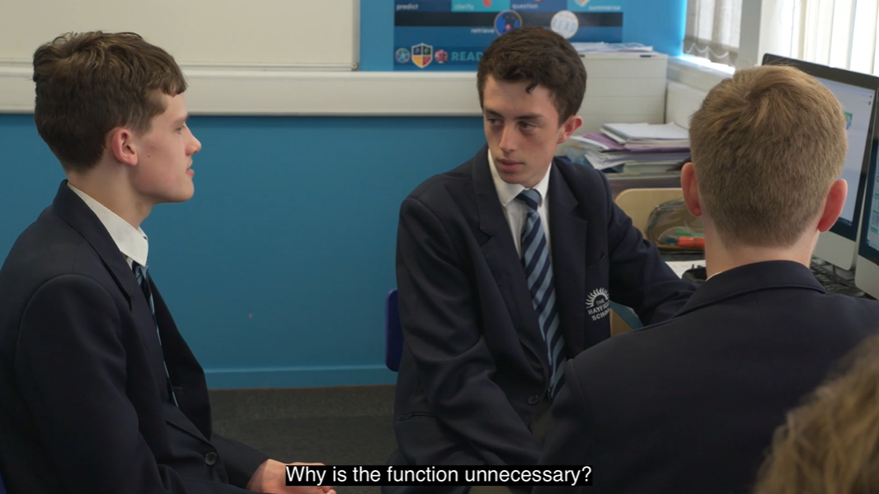
Oracy in action
Are they speaking at an appropriate volume? How do they vary their tone of voice? Are they using hand gestures to support their ideas?
Do they use ambitious, technical or subject-specific vocabulary? Do they speak with an appropriate level of formality?
Do their responses build on each other’s? Do they give reasons for their opinions? Do they critically engage with each other’s ideas? Do they ask questions?
How do students show they are listening? Do they make sure everyone gets a turn to speak? Is there an appropriate balance of contributions?

Slide 18
Notes:
https://vimeo.com/719776810/18a1d440a4

Slide 19
Notes:
Start at 3:19

Slide 20
Oracy in action
A: I noticed that…
To improve, they could..
B: Building on your idea…
I agree/ disagree…because
Silent summariser
C: The main points you raised were…
Key Words
cognitive, linguistic, social emotional, physical

Slide 21

Key ideas
The hallmarks of good oracy change depending on the context in which someone is speaking.
Your expectations for oracy should differ depending on whether you are asking students to engage in exploratory or presentational talk.
The Oracy Framework can support you to identify and teach the oracy skills required in different contexts.

Slide 22

Reflection
What is one change you will make in your practice starting today, next week and next term as a result of this session?

Slide 23
Next steps
We will
Plan opportunities for exploratory and presentational talk using the Oracy Framework as a tool to set, model and scaffold expectations for talk.
Introduce the Oracy Framework to students as a tool to develop their understanding of oracy and support self and peer reflection.

Slide 24





GET IN TOUCH
www.voice21.org hello@voice21.org
CONNECT ON SOCIAL
@voice21oracy.bsky.social @voice21oracy Voice 21 UK

