Slide 1


Voice 21 Study Group:
Talk Circles
2: Paired Talk

Slide 2
Aims
Understand
The Oracy Benchmarks
The characteristics of effective partner talk
How to set and reinforce high expectations for partner talk
Do
Reflect on current practice and set goals for oracy in your classroom
Analyse examples of oracy classroom practice

Slide 3

What are the Oracy Benchmarks?
“
The Benchmarks provide a framework to identify, guide and empower teachers who are developing and refining their oracy practice […] as part of a school-wide approach.
”

Slide 4
What are the Oracy Benchmarks?
1
2
Sets high expectations for oracy
Values every voice
4
3
Harnesses oracy to elevate learning
Teaches oracy explicitly
5
Appraises progress in oracy

Slide 5

Reflecting using the Oracy Benchmarks
A: Tell me about how you use oracy in your classroom to … ?
Can you tell me more about …?
B: One thing I already do is …
I’ve found … to be effective because…
Evaluate: which of the Oracy Teacher Benchmarks do you feel most confident about?
Which would you like to learn more about?

Slide 6
Oracy in action
1
Sets high expectations for oracy
A: I think...because…
B: I agree/ disagree because…
Building on your idea…
What were the expectations for paired talk? How were these shared?
How were students supported to meet these expectations?
Did you notice any other teacher benchmarks in action?

Slide 7
Notes:
https://vimeo.com/1128147991

Slide 8
Notes:
https://vimeo.com/1128149208?share=copy&fl=sv&fe=ci

Slide 9

Key ideas
To engage in productive paired talk, students must understand the expectations for talk in this format.
Scaffolds, such as sentence stems, key words and modelling, give students the tools they need to reach a higher standard of talk than they may achieve independently.

Slide 10
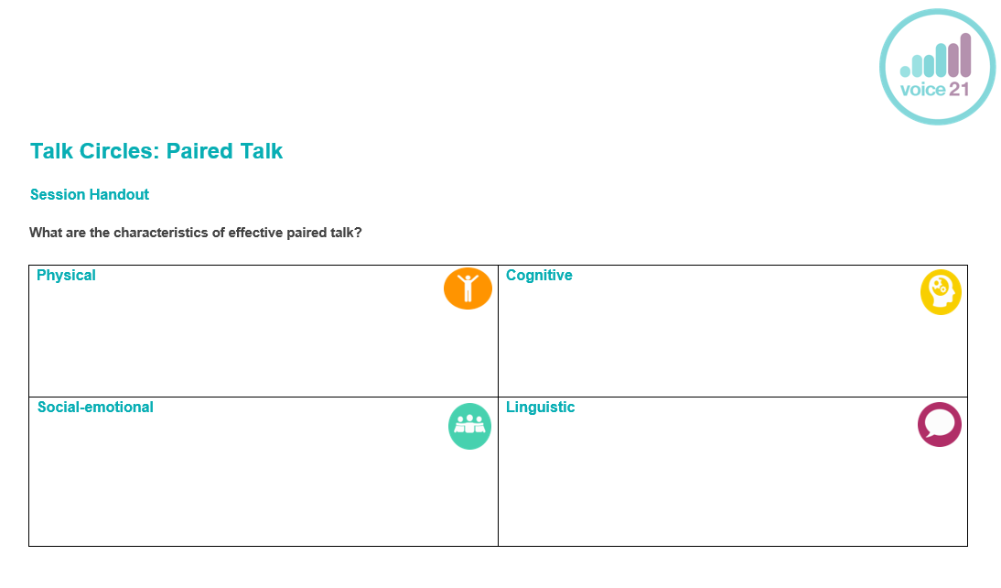
Setting high expectations
What are the characteristics of effective paired talk?
How could you scaffold students’ paired talk to achieve these?

Slide 11
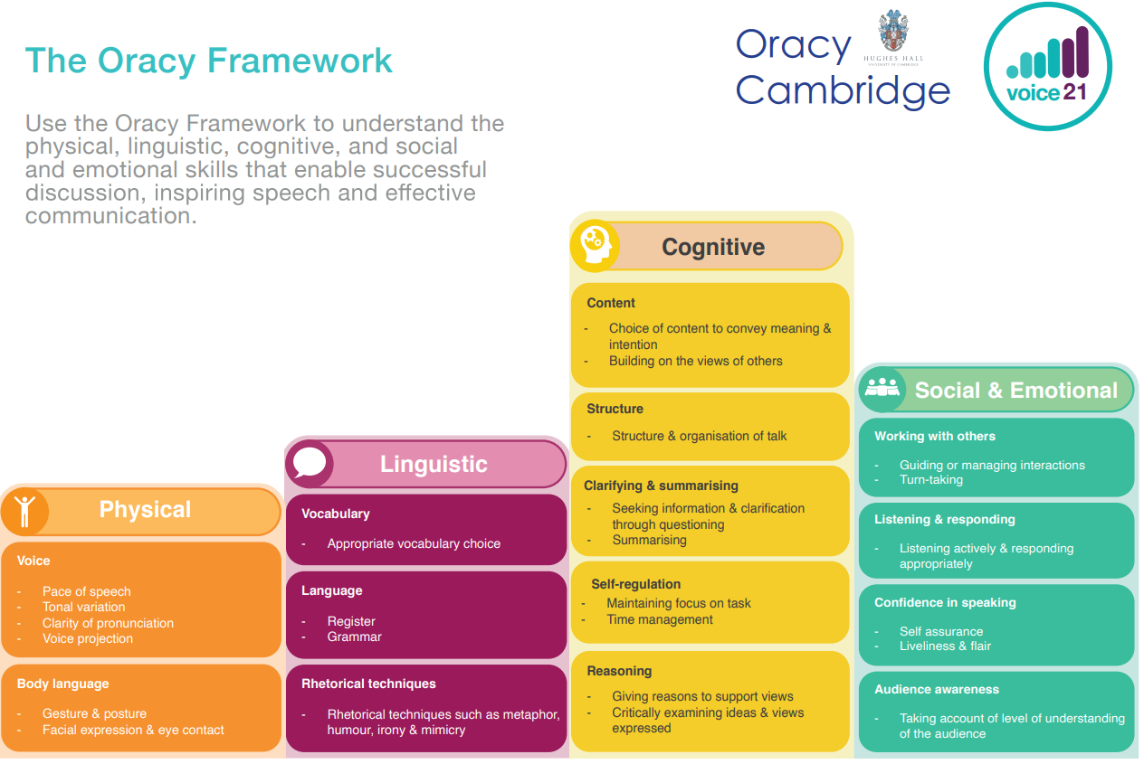

Slide 12
Oracy in action
5
Appraises progress in oracy
A: I think...because…
B: I agree/ disagree because…
Building on your idea…
What feedback did the teacher give students on their oracy?
What other feedback could the teacher have given?
How does this reinforce their expectations for effective paired talk?
Key words: physical, linguistic, cognitive, social-emotional

Slide 13
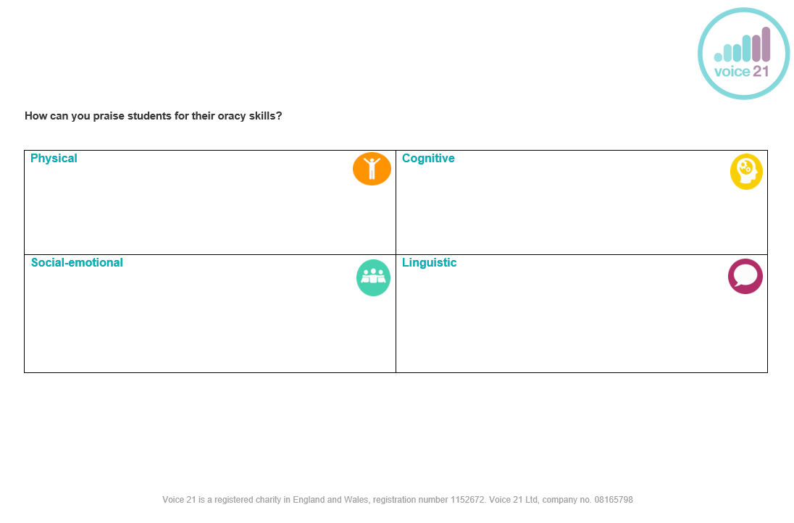
Praise for oracy
What specific praise can you give students for their oracy skills?
How can this reinforce your expectations for effective paired talk?

Slide 14
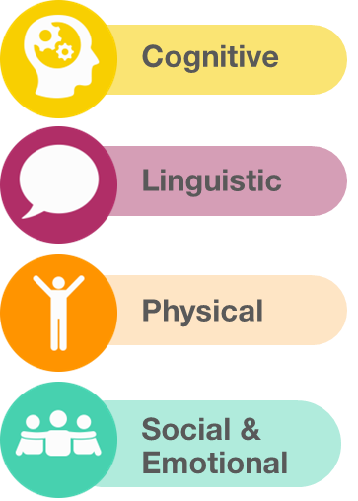
Praise for oracy
“You offered a great challenge!”
“Great specialist vocabulary; you sounded like an expert”
“Your body language showed me you were open to others’ ideas”
“Well done for inviting X into the discussion”

Slide 15
Key ideas
Praising students for their oracy raises their awareness and understanding of specific oracy skills.
The Oracy Framework can support you to give students’ targeted praise for the oracy skills you are working to embed.

Slide 16
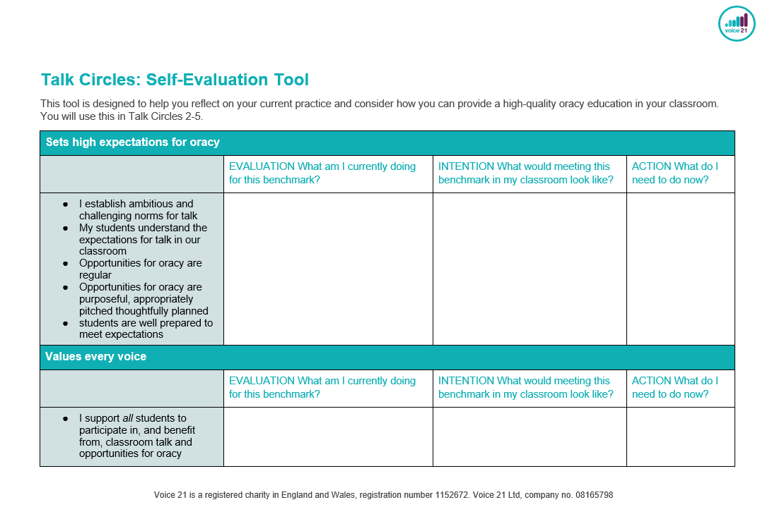
Self-evaluation
Use the self-evaluation tool to reflect on your current practice and plan how you will develop this moving forwards.

Slide 17
Next steps
We will
Share our expectations for paired talk with students and provide scaffolds for students to meet these expectations.
Reinforce these expectations through targeted and specific praise for oracy.

Slide 18
Email us: hello@voice21.org
Tweet us: @voice21oracy
You can also follow us on Facebook or LinkedIn @ Voice 21
Work with us: www.voice21.org

